Slide 1

Linux Character Device_Part2
2017 yuANTL Lab. Seminar
OCTOBER 23, 2017
양지혁
Advanced Networking Technology Lab. (YU-ANTL)
Dept. of Information & Comm. Eng
Yeungnam University, KOREA
(Tel : +82-53-810-3940; http://antl.yu.ac.kr/; E-mail : flash0223@ynu.ac.kr)

Slide 2
Outline
Simple GPIO Character Device Driver
IOCTL Programming
Simple IOCTL Device Driver
IOCTL Macro
Simple IOCTL Device Driver with Macro
GPIO Character Device Driver with IOCTL Programming

Slide 3
Simple GPIO Character Device Driver(1)
simple_gpiodev.c description
This Simple_gpiodev.c module uses only two pins.
Input pin is BCM 17 pin.
Output pin is BCM 27 pin.
The gpio pins initialization is happened at module open or init.
When write() function is called, the gpio pins initialization is happened.
When input pin value is 1 to 0, interrupt is generated.
interrupt handler function has
output value toggle.
sending MY_SIGNAL(Signal Number is 34).

Slide 4
Simple GPIO Character Device Driver(2)
simple_gpiodev.c file (1)
/*simple_gpiodev.c(1)*/
#include<linux/module.h>
#include<linux/kernel.h>
#include<linux/init.h>
#include<linux/interrupt.h>
#include<linux/gpio.h>
#include<asm/uaccess.h>
#include<linux/fs.h>
#include<linux/signal.h>
#include<linux/sched.h>
#include<linux/slab.h>
#include<linux/device.h>
#include<linux/cdev.h>
#define DRIVER_AUTHOR "YJH"
#define DRIVER_DESC "Test sending signal triggered by gpio."
#define DEVICE_NAME "simple_gpiodev"
#define READ_BUFF_LEN 6
#define GPIO_INPUT_PIN 27
#define GPIO_INPUT_PIN_DESC "BCM 27"
#define GPIO_INPUT_PIN_DEVICE_DESC "Signal trigger gpio pin."
#define GPIO_OUTPUT_PIN 17
#define GPIO_OUTPUT_PIN_DESC "BCM 17"
#define MY_SIGNAL 34
/*simple_gpiodev.c (2)*/
//Module params declaration block
short int gpio_pin = GPIO_INPUT_PIN;
//Interrupts variables block
short int irq_gpio_pin = GPIO_INPUT_PIN;
short int irq_enabled = 0;
//Function variables block
pid_t send_to_pid = 0; //store pid of process
short int signal_to_pid = MY_SIGNAL;
//device registration variables
struct class *myclass;
struct cdev *mycdev;
struct device *mydevice;
dev_t mydev;
int simple_gpiodev_open(struct inode *, struct file *);
int simple_gpiodev_release(struct inode *, struct file *);
ssize_t simple_gpiodev_write(struct file *, const char *, size_t, loff_t *);
struct file_operations fops = {
.write = simple_gpiodev_write,
.open = simple_gpiodev_open,
.release = simple_gpiodev_release
};

Slide 5
Simple GPIO Character Device Driver(3)
simple_gpiodev.c file (2)
/*simple_gpiodev.c(3)*/
static irqreturn_t my_irq_handler(int irq, void* dev_id);
void my_int_config(void);
void my_int_release(void);
int find_my_task(int task_pid);
void signal_config(void);
int irq_gpio_input = 0;
//Signal variables
struct task_struct *t;
struct siginfo info;
int simple_gpiodev_open(struct inode *inode, struct file *file)
{
printk(KERN_ALERT "[simple_gpiodev] device open\n");
return 0;
}
int simple_gpiodev_release(struct inode *inode, struct file *file)
{
my_int_release();
printk(KERN_ALERT "[simple_gpiodev] device release\n");
return 0;
}
/*simple_gpiodev.c (4)*/
int mod_init(void)
{
if(alloc_chrdev_region(&mydev,0,1,"simple_gpiodev")<0)
return -EBUSY;
myclass = class_create(THIS_MODULE, "simple_gpiodev");
if(IS_ERR(myclass))
{
unregister_chrdev_region(mydev,1);
return PTR_ERR(myclass);
}
mydevice = device_create(myclass, NULL, mydev, NULL, "simple_gpiodev");
if(IS_ERR(mydevice))
{
class_destroy(myclass);
unregister_chrdev_region(mydev,1);
return PTR_ERR(mydevice);
}
mycdev = cdev_alloc();
mycdev->ops = &fops;
mycdev->owner = THIS_MODULE;
if(cdev_add(mycdev, mydev,1)<0)
{
device_destroy(myclass,mydev);
class_destroy(myclass);
unregister_chrdev_region(mydev,1);
return -EBUSY;
}
}

Slide 6
Simple GPIO Character Device Driver(4)
simple_gpiodev.c file (3)
/*simple_gpiodev.c(5)*/
static irqreturn_t my_irq_handler(int irq, void *dev_id)
{
unsigned long flags;
int curVal;
int ret;
local_irq_save(flags);
curVal = gpio_get_value(GPIO_OUTPUT_PIN);
curVal = 1-curVal;
gpio_set_value(GPIO_OUTPUT_PIN, curVal);
ret = send_sig_info(MY_SIGNAL, &info, t);
if(ret<0)
{
printk("error sending signal!!\n");
return ret;
}
printk(KERN_ALERT "[simple_gpiodev] Interrupt [%d] for device %s was triggered \n", irq, (char *)dev_id);
local_irq_restore(flags);
return IRQ_HANDLED;
}
/*simple_gpiodev.c (6)*/
int find_my_task(int task_pid)
{
t = pid_task(find_vpid(task_pid),PIDTYPE_PID);
if(t==NULL)
{
printk("no such pid \n");
return -1;
}
return 0;
}
void signal_config(void)
{
memset(&info, 0, sizeof(struct siginfo));
info.si_signo = MY_SIGNAL;
info.si_code = SI_QUEUE;
}
void my_int_release(void)
{
free_irq(irq_gpio_input, GPIO_INPUT_PIN_DEVICE_DESC);
gpio_free(GPIO_INPUT_PIN);
gpio_free(GPIO_OUTPUT_PIN);
}
void mod_exit(void)
{
cdev_del(mycdev);
device_destroy(myclass, mydev);
class_destroy(myclass);
unregister_chrdev_region(mydev,1);
}

Slide 7
Simple GPIO Character Device Driver(5)
simple_gpiodev.c file (4)
/*simple_gpiodev.c(7)*/
void my_int_config(void)
{
if(gpio_request(GPIO_INPUT_PIN, GPIO_INPUT_PIN_DESC))
{
printk(KERN_ALERT "[simple_gpiodev] GPIO request failure %s\n", GPIO_INPUT_PIN_DESC);
return ;
}
if(gpio_request(GPIO_OUTPUT_PIN, GPIO_OUTPUT_PIN_DESC))
{
printk(KERN_ALERT "[simple_gpiodev] GPIO request failure %s\n", GPIO_OUTPUT_PIN_DESC);
return ;
}
if(gpio_direction_input(GPIO_INPUT_PIN))
{
printk(KERN_ALERT "[simple_gpiodev] GPIO direction configuration failure :%s\n", GPIO_INPUT_PIN_DESC);
return ;
}
/*simple_gpiodev.c (8)*/
if(gpio_direction_output(GPIO_OUTPUT_PIN,0))
{
printk(KERN_ALERT"[simple_gpiodev] GPIO direction configuration failure : %s\n", GPIO_OUTPUT_PIN_DESC);
return ;
}
irq_gpio_input = gpio_to_irq(GPIO_INPUT_PIN);
printk(KERN_ALERT"[simple_gpiodev] Mapped int %d\n", irq_gpio_input);
if(irq_gpio_input<0)
{
printk(KERN_ALERT"[simple_gpiodev] GPIO to IRQ mapping failure %s\n", GPIO_INPUT_PIN_DESC);
return ;
}
if(request_irq(irq_gpio_input,(irq_handler_t)my_irq_handler, IRQF_TRIGGER_FALLING, GPIO_INPUT_PIN_DESC, GPIO_INPUT_PIN_DEVICE_DESC))
{
printk(KERN_ALERT "[simple_gpiodev] IRQ request failure\n ");
return ;
}
}

Slide 8
Simple GPIO Character Device Driver(6)
simple_gpiodev.c file (5)
/*simple_gpiodev.c(9)*/
ssize_t simple_gpiodev_write(struct file *filp, const char *buf, size_t count, loff_t *f_pos)
{
int pid;
copy_from_user(&pid, buf, sizeof(count));
printk(KERN_ALERT "[simple_gpiodev] device write function called! pid = %d",pid);
find_my_task(pid);
signal_config();
my_int_config();
return count;
}
module_init(mod_init);
module_exit(mod_exit);
MODULE_LICENSE("GPL");
MODULE_AUTHOR(DRIVER_AUTHOR);
MODULE_DESCRIPTION(DRIVER_DESC);

Slide 9
Simple GPIO Character Device Driver(7)
AppforGPIO_chrdev.c file
It is same AppforSimple_chrdev.c
/*AppforGPIO_chrdev.c (1)*/
#include<stdio.h>
#include<unistd.h>
#include<sys/fcntl.h>
#include<signal.h>
#include<string.h>
#define MY_SIGNAL 34
void sig_handler(int signo);
int main()
{
int dev;
int pid;
struct sigaction act;
printf(“My GPIO Character Device Test\n”);
dev = open(“dev/simple_gpiodev”, O_RDWR);
printf(“dev : %d\n”,dev);
if(dev<0)
{
printf(“device file open error\n”);
return -1;
}
pid = getpid();
/*AppforGPIO_chrdev.c (2)*/
printf(“pid : %d\n”, pid);
write(dev, (char *)&pid,sizeof(int));
memset(&act, ‘\0’, sizeof(act));
act.sa_handler = &sig_handler;
if(sigaction(MY_SIGNAL, &act,NULL)<0)
{
perror(“sigaction”);
return 1;
}
while(1)
{
}
}
void sig_handler(int signo)
{
printf(“I Received MY_SIGNAL(%d)\n”, MY_SIGNAL);
}

Slide 10
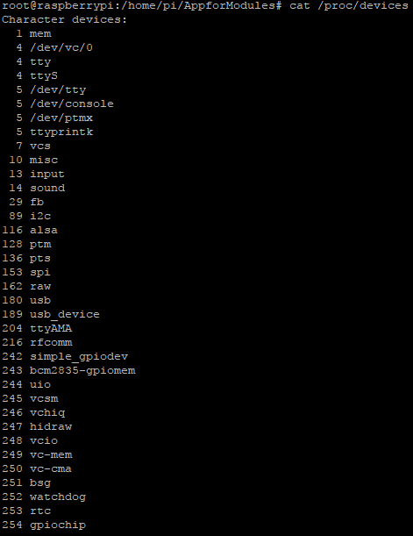
Simple GPIO Character Device Driver(8)
Confirm major number
Use $cat /proc/devices

Slide 11


Simple GPIO Character Device Driver(9)
Result
After execution Application
Application Message
kernel Message

Slide 12
IOCTL Programming (1)
ioctl()
Location
#include<sys/ioctl.h>
Function Prototype
int ioctl(int fd, int request, unsigned long arg);
Description
It is a system call for device-specific input/output operations and other operations which cannot be expressed by regular system calls.
It takes a parameter specifying a request code.
The effect of a call depends completely on the request code.
Request codes are often device-specific.
Parameter
int fd
File descriptor.
int request
request code.
ioctl executes function by request number.
unsigned long arg
argument from user.

Slide 13
IOCTL Programming (2)
왜 우리는 IOCTL 프로그래밍이 필요한가?
디바이스와 데이터를 주고 받는 함수는 존재한다.
디바이스로 부터 데이터를 받을 땐 read().
디바이스한테 데이터를 줄 땐 write().
IOCTL은 configuration하기 위해 존재한다.
SPI를 예로 들면
통신 속도, 핀 번호, mode 설정 등등을 위한 함수들이 필요하다.
이러한 Configuration이나 read(), write()이외에 함수가 더 필요할 때 IOCTL() 함수를 사용한다.

Slide 14
IOCTL Programming (3)
ioctl()
Location
#include<sys/ioctl.h>
Function Prototype
int ioctl(int fd, int request, unsigned long arg);
Description
It is a system call for device-specific input/output operations and other operations which cannot be expressed by regular system calls.
It takes a parameter specifying a request code.
The effect of a call depends completely on the request code.
Request codes are often device-specific.
Parameter
int fd
File descriptor.
int request
request code.
ioctl executes function by request number.
unsigned long arg
argument from user.

Slide 15
IOCTL Programming (4)
IOCTL Structure
ret = ioctl(int fd, int request, char *argp);
User Space
ioctl(struct inode *inode, struct file *filp, unsigned int cmd, unsigned long arg)
{
switch(cmd)
{
case constance; process routine;break;
}
return retVal;
}
Kernel Space

Slide 16
IOCTL Programming (5)
ioctl(), unlocked_ioctl(), compat_ioctl()
ioctl()
It is deleted after linux kernel version 2.6.
unlocked_ioctl() and compat_ioctl into 2.6.11.
The removal of the ioctl field happended a lot later , in 2.6.36.
It is protected by BKL(Big Kernel Lock).
Big Kernel Lock is lock for all CPU.
When ioctl was executed, it took the BKL, so nothing else could execute at the same time.
It is very bad on a multiprocessor machine, so there was a big effort to get rid of the BKL.
unlocked_ioctl()
It lets each driver writer choose what lock to use instead.
This can be difficult
so there was a period of transition during which old drivers still worked (using ioctl).
but new drivers could use the improved interface (unlocked_ioctl).
All drivers were converted and ioctl could be removed.
compat_ioctl()
Its purpose is to allow 32-bit userland programs to make ioctl calls on a 64-bit kernel.

Slide 17
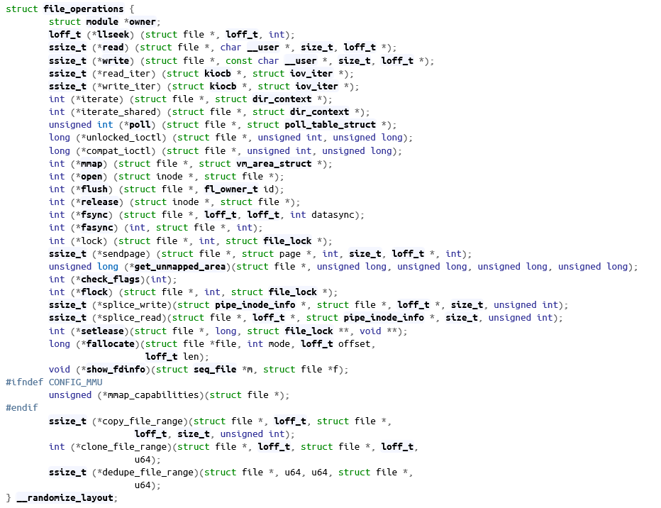
IOCTL Programming (6)
Latest struct file_operations

Slide 18
Simple IOCTL Device Driver (1)
simpleIOCTL_chrdev.c (1)
/*simpleIOCTL_chrdev.c (1)*/
#include<linux/init.h>
#include<linux/kernel.h>
#include<linux/module.h>
#include<linux/fs.h>
#include<linux/slab.h>
#include<linux/device.h>
#include<linux/cdev.h>
#define DRIVER_AUTHOR "YJH"
#define DRIVER_DESC "Simple IOCTL Character Device Driver"
MODULE_LICENSE("GPL");
MODULE_AUTHOR(DRIVER_AUTHOR);
MODULE_DESCRIPTION(DRIVER_DESC);
struct class *myclass;
struct cdev *mycdev;
struct device *mydevice;
dev_t mydev;
int simpleIOCTL_chrdev_open(struct inode* inode, struct file *filp)
{
printk("[simpleIOCTL_chrdev]device open\n");
return 0;
}
int simpleIOCTL_chrdev_release(struct inode* inode, struct file *filp)
{
printk("[simpleIOCTL_chrdev]device release\n");
return 0;
}
/*simpleIOCTL_chrdev.c (2)*/
long simpleIOCTL_chrdev_ioctl(struct file *filp, unsigned int cmd, unsigned long arg)
{
switch(cmd)
{
case 1:
printk("[simpleIOCTL_chrdev] ioctl read...\n");
break;
case 3:
printk("[simpleIOCTL_chrdev] ioctl write...\n");
break;
default:
printk("[simpleIOCTL_chrdev] ioctl unknown command...\n");
break;
}
return 0;
}
struct file_operations simpleIOCTL_chrdev_fops =
{
.owner = THIS_MODULE,
.open = simpleIOCTL_chrdev_open,
.release = simpleIOCTL_chrdev_release,
.unlocked_ioctl = simpleIOCTL_chrdev_ioctl
};

Slide 19
Simple IOCTL Device Driver (2)
simpleIOCTL_chrdev.c (2)
/*simpleIOCTL_chrdev.c (3)*/
int mod_init(void)
{
if(alloc_chrdev_region(&mydev,0,1,"simpleIOCTL_chrdev")<0)
return -EBUSY;
myclass = class_create(THIS_MODULE, "simpleIOCTL_chrdev");
if(IS_ERR(myclass))
{
unregister_chrdev_region(mydev,1);
return PTR_ERR(myclass);
}
mydevice = device_create(myclass,NULL,mydev,NULL,"simpleIOCTL_chrdev");
if(IS_ERR(mydevice))
{
class_destroy(myclass);
unregister_chrdev_region(mydev,1);
return PTR_ERR(mydevice);
}
mycdev = cdev_alloc();
mycdev->ops = &simpleIOCTL_chrdev_fops;
mycdev->owner = THIS_MODULE;
/*simpleIOCTL_chrdev.c (4)*/
if(cdev_add(mycdev, mydev, 1)<0)
{
device_destroy(myclass, mydev);
class_destroy(myclass);
unregister_chrdev_region(mydev,1);
return -EBUSY;
}
return 0;
}
void mod_exit(void)
{
cdev_del(mycdev);
device_destroy(myclass, mydev);
class_destroy(myclass);
unregister_chrdev_region(mydev,1);
}
module_init(mod_init);
module_exit(mod_exit);

Slide 20
Simple IOCTL Device Driver (3)
AppforSimple_IOCTL.c
/*AppforSimple_IOCTL.c*/
#include<stdio.h>
#include<unistd.h>
#include<sys/fcntl.h>
#include<sys/ioctl.h>
int main()
{
int dev;
printf(“Simple IOCTL Character Device Test\n”);
dev = open(“/dev/simpleIOCTL_chrdev”, O_RDWR);
if(dev<0)
{
printf(“device file open error\n”);
return -1;
}
ioctl(dev,1);
ioctl(dev,3);
ioctl(dev,4);
close(dev);
return 0;
}

Slide 21

Simple IOCTL Device Driver (4)
Result
Kernel Message
Application Message

Slide 22
IOCTL Macro (1)
IOCTL cmd구조
cmd structure
It is defined /linux/include/uapi/asm-generic/ioctl.h
Structure is different by architecture.
Below picture is generic cmd structure.
2 bit
8 bit
8 bit
14 bit
Direction
Magic Number
Command Number
Data Size
32 30
22 14
Type | Bit | Description
Direction | 2 | Read/Write Property
Magic Num | 8 | Device Delimiter Value
Type Num | 8 | Command Number
Size | 14 | Size of Parameter

Slide 23
IOCTL Macro (2)
IOCTL cmd Macro
It is defined /linux/include/uapi/asm-generic/ioctl.h
Macro Type
_IO(Magic Number, Type Number)
No Parameter Macro
_IOR(Magic Number, Type Number, Variable Type)
For Data Read Command Macro
_IOW(Magic Number, Type Number, Variable Type)
For Data Write Command Macro
_IOWR(Magic Number, Type Number, Variable Type)
For Data Read/Write Command Macro
Example
#define MY_IOCTL_READ _IOR(MY_IOCTL_NUMBER, 0, int)
#define MY_IOCTL_WRITE _IOW(MY_IOCTL_NUMBER, 1, int)
#define MY_IOCTL_STATUS _IO(MY_IOCTL_NUMBER, 2)
#define MY_IOCTL_READ_WRITE _IOWR(MY_IOCTL_NUMBER, 3, int)

Slide 24
IOCTL Macro (3)
IOCTL cmd Interpretation Macro
It is defined /linux/include/uapi/asm-generic/ioctl.h
Macro Type
_IOC_NR
Macro for Type number
_IOC_TYPE
Macro for magic number
_IOC_SIZE
Macro for Data size
_IOC_DIR
Macro for direction field

Slide 25
Simple IOCTL Device Driver with Macro (1)
IOCTLMacro_chrdev.c (Character Device Driver File)
/*IOCTLMacro_chrdev.c (1)*/
#include<linux/init.h>
#include<linux/kernel.h>
#include<linux/module.h>
#include<linux/fs.h>
#include<asm/uaccess.h>
#include<linux/slab.h>
#include<linux/cdev.h>
#include<linux/device.h>
#define DRIVER_AUTHOR "YJH"
#define DRIVER_DESC "Simple IOCTL Character Device Driver with Macro"
#define DEVICE_NAME "IOCTLMacro_chrdev"
#define MY_IOCTL_NUMBER 100
#define MY_IOCTL_READ _IOR(MY_IOCTL_NUMBER, 0, int)
#define MY_IOCTL_WRITE _IOW(MY_IOCTL_NUMBER, 1, int)
#define MY_IOCTL_STATUS _IO(MY_IOCTL_NUMBER, 2)
#define MY_IOCTL_READ_WRITE _IOWR(MY_IOCTL_NUMBER, 3, int)
#define MY_IOCTL_NR 4
MODULE_LICENSE("GPL");
MODULE_AUTHOR(DRIVER_AUTHOR);
MODULE_DESCRIPTION(DRIVER_DESC);
struct class *myclass;
struct cdev *mycdev;
struct device *mydevice;
dev_t mydev;
/*IOCTLMacro_chrdev.c (2)*/
int data=0;
int IOCTLMacro_chrdev_open(struct inode* inode, struct file *filp)
{
printk("[IOCTLMacro_chrdev] device open\n");
return 0;
}
int IOCTLMacro_chrdev_release(struct inode* inode, struct file *filp)
{
printk("[IOCTLMacro_chrdev] device release\n");
return 0;
}
long IOCTLMacro_chrdev_ioctl(struct file *filp, unsigned int cmd, unsigned long arg)
{
int err = 0, size;
if(_IOC_TYPE(cmd) != MY_IOCTL_NUMBER) return -EINVAL;
if(_IOC_NR(cmd) >= MY_IOCTL_NR) return -EINVAL;
if(_IOC_DIR(cmd) & _IOC_READ)
{
err = access_ok(VERIFY_READ, (void *)arg, sizeof(unsigned long));
if(err<0) return -EINVAL;
}
else if(_IOC_DIR(cmd) & _IOC_WRITE)
{
err = access_ok(VERIFY_WRITE, (void *)arg, sizeof(unsigned long));
if(err<0) return -EINVAL;
}
size = _IOC_SIZE(cmd);

Slide 26
Simple IOCTL Device Driver with Macro (2)
IOCTLMacro_chrdev.c (Character Device Driver File)
/*IOCTLMacro_chrdev.c (3)*/
switch(cmd)
{
case MY_IOCTL_READ:
printk("[IOCTLMacro_chrdev] read called...\n");
copy_to_user((void *)arg, (const void*)&data, (unsigned long)size);
printk("[IOCTLMacro_chrdev] IOCTL_READ in kernel space : %d\n", data);
break;
case MY_IOCTL_WRITE:
printk("[IOCTLMacro_chrdev] write called...\n");
copy_from_user((void *)&data, (const void*)&arg, (unsigned long)size);
printk("[IOCTLMacro_chrdev] write :%d\n", data);
break;
case MY_IOCTL_STATUS:
printk("[IOCTLMacro_chrdev] status called....\n");
break;
case MY_IOCTL_READ_WRITE:
printk("[IOCTLMacro_chrdev] READ_WRITE called....\n");
copy_from_user((void *)&data, (const void*)arg, (unsigned long)size);
printk("[IOCTLMacro_chrdev] IOCTL_READ_WRITE data : %d\n",data);
data+=900;
copy_to_user((void *)arg, (const void*)&data, (unsigned long)size);
printk("[IOCTLMacro_chrdev] IOCTL_READ_WRITE data : %d\n",data);
break;
default:
printk("[IOCTLMacro_chrdev] Unknown command...\n");
break;
}
return 0;
}

Slide 27
Simple IOCTL Device Driver with Macro (3)
IOCTLMacro_chrdev.c (Character Device Driver File)
/*IOCTLMacro_chrdev.c (4)*/
static struct file_operations IOCTLMacro_chrdev_fops = {
.owner = THIS_MODULE,
.open = IOCTLMacro_chrdev_open,
.release = IOCTLMacro_chrdev_release,
.unlocked_ioctl = IOCTLMacro_chrdev_ioctl
};
int mod_init(void)
{
if(alloc_chrdev_region(&mydev, 0, 1, DEVICE_NAME))
return -EBUSY;
myclass = class_create(THIS_MODULE, DEVICE_NAME);
if(IS_ERR(myclass))
{
unregister_chrdev_region(mydev,1);
return PTR_ERR(myclass);
}
mydevice = device_create(myclass, NULL, mydev, NULL, DEVICE_NAME);
if(IS_ERR(mydevice))
{
class_destroy(myclass);
unregister_chrdev_region(mydev,1);
return PTR_ERR(mydevice);
}
/*IOCTLMacro_chrdev.c (5)*/
mycdev = cdev_alloc();
mycdev->ops = &IOCTLMacro_chrdev_fops;
mycdev->owner = THIS_MODULE;
if(cdev_add(mycdev, mydev, 1)<0)
{
device_destroy(myclass, mydev);
class_destroy(myclass);
unregister_chrdev_region(mydev,1);
return -EBUSY;
}
return 0;
}
void mod_exit(void)
{
cdev_del(mycdev);
device_destroy(myclass, mydev);
class_destroy(myclass);
unregister_chrdev_region(mydev,1);
}
module_init(mod_init);
module_exit(mod_exit);

Slide 28
Simple IOCTL Device Driver with Macro (4)
AppforIOCTL_macro.c (User Application File)
/*AppforIOCTL_macro.c (1)*/
#include<stdio.h>
#include<stdlib.h>
#include<unistd.h>
#include<sys/fcntl.h>
#include<sys/ioctl.h>
#define DEVICE_NAME "/dev/IOCTLMacro_chrdev"
#define MY_IOCTL_NUMBER 100
#define MY_IOCTL_READ _IOR(MY_IOCTL_NUMBER, 0, int)
#define MY_IOCTL_WRITE _IOW(MY_IOCTL_NUMBER, 1, int)
#define MY_IOCTL_STATUS _IO(MY_IOCTL_NUMBER, 2)
#define MY_IOCTL_READ_WRITE _IOWR(MY_IOCTL_NUMBER, 3, int)
#define MY_IOCTL_NR 4
int main()
{
int dev;
int data=100;
dev = open(DEVICE_NAME, O_RDWR);
if(dev<0) exit(EXIT_FAILURE);
printf("\n------------------------------------------------------\n");
printf("[App Message READ] Before IOCTL READ, data = %d\n",data);
ioctl(dev, MY_IOCTL_READ, &data);
printf("[App Message READ] After IOCTL READ, data = %d\n", data);
printf("\n------------------------------------------------------\n");
printf("[App Message WRITE] Before IOCTL WRITE, data = %d\n", data);

Slide 29
Simple IOCTL Device Driver with Macro (5)
AppforIOCTL_macro.c (User Application File)
/*AppforIOCTL_macro.c (2)*/
data=200;
ioctl(dev, MY_IOCTL_WRITE, &data);
ioctl(dev, MY_IOCTL_READ, &data);
printf("[App Message WRITE] After IOCTL WRITE, data = %d\n", data);
printf("\n------------------------------------------------------\n");
printf("[App Message STATUS] IOCTL STATUS\n");
ioctl(dev, MY_IOCTL_STATUS);
printf("\n------------------------------------------------------\n");
data = 400;
printf("[App Message READ WRITE] Before IOCTL_READ_WRITE, data = %d\n",data);
ioctl(dev, MY_IOCTL_READ_WRITE, &data);
printf("[App Message READ WRITE] After IOCTL_READ_WRITE, data = %d\n",data);
close(dev);
return 0;
}

Slide 30
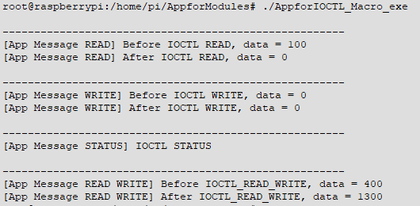
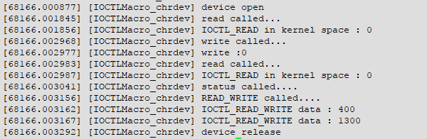
Simple IOCTL Device Driver with Macro (6)
Result
Application Message
Kernel Message

Slide 31
GPIO Simple IOCTL (1)
ioctl_gpiodev.c (Character Device Driver File)
/*ioctl_gpiodev.c (1)*/
#include<linux/module.h>
#include<linux/kernel.h>
#include<linux/init.h>
#include<linux/interrupt.h>
#include<linux/gpio.h>
#include<asm/uaccess.h>
#include<linux/fs.h>
#include<linux/signal.h>
#include<linux/sched.h>
#include<linux/slab.h>
#include<linux/device.h>
#include<linux/cdev.h>
#define DRIVER_AUTHOR "YJH"
#define DRIVER_DESC "Test IOCTL Function with GPIO Output Pin"
#define DEVICE_NAME "ioctl_gpiodev"
#define READ_BUFF_LEN 6
#define GPIO_OUTPUT_PIN27 27
#define GPIO_OUTPUT_PIN27_DESC "BCM 27"
#define GPIO_OUTPUT_PIN17 17
#define GPIO_OUTPUT_PIN17_DESC "BCM 17"
/*ioctl_gpiodev.c (2)*/
#define MY_IOCTL_NUMBER 102
#define MY_IOCTL_PIN27 _IO(MY_IOCTL_NUMBER, 0)
#define MY_IOCTL_PIN17 _IO(MY_IOCTL_NUMBER, 1)
#define MY_IOCTL_NR 3
//Module params declaration block
int cur_gpio_pin = GPIO_OUTPUT_PIN27;
//device registration variables
struct class *myclass;
struct cdev *mycdev;
struct device *mydevice;
dev_t mydev;
int ioctl_gpiodev_open(struct inode *, struct file *);
int ioctl_gpiodev_release(struct inode *, struct file *);
long ioctl_gpiodev_ioctl(struct file *filp, unsigned int cmd, unsigned long arg);
struct file_operations fops = {
.open = ioctl_gpiodev_open,
.release = ioctl_gpiodev_release,
.unlocked_ioctl = ioctl_gpiodev_ioctl
};

Slide 32
GPIO Simple IOCTL (2)
/*ioctl_gpiodev.c (3)*/
int ioctl_gpiodev_open(struct inode *inode, struct file *file)
{
printk(KERN_ALERT "[ioctl_gpiodev] device open\n");
if(gpio_request(GPIO_OUTPUT_PIN27, GPIO_OUTPUT_PIN27_DESC))
{
printk(KERN_ALERT "[ioctl_gpiodev] GPIO request failure %s\n", GPIO_OUTPUT_PIN27_DESC);
return -1;
}
if(gpio_direction_output(GPIO_OUTPUT_PIN27,1))
{
printk(KERN_ALERT"[ioctl_gpiodev] GPIO direction configuration failure : %s\n", GPIO_OUTPUT_PIN27_DESC);
return -2;
}
cur_gpio_pin = GPIO_OUTPUT_PIN27;
return 0;
}
int ioctl_gpiodev_release(struct inode *inode, struct file *file)
{
gpio_free(cur_gpio_pin);
printk(KERN_ALERT "[ioctl_gpiodev] device release\n");
return 0;
}
void mod_exit(void)
{
// my_int_release();
cdev_del(mycdev);
device_destroy(myclass, mydev);
class_destroy(myclass);
unregister_chrdev_region(mydev,1);
}

Slide 33
GPIO Simple IOCTL (3)
/*ioctl_gpiodev.c (4)*/
long ioctl_gpiodev_ioctl(struct file *filp, unsigned int cmd, unsigned long arg)
{
int err=0, size;
int data=0;
if(_IOC_TYPE(cmd) != MY_IOCTL_NUMBER) return -EINVAL;
if(_IOC_NR(cmd) >= MY_IOCTL_NR) return -EINVAL;
if(_IOC_DIR(cmd) & _IOC_READ)
{
err = access_ok(VERIFY_READ, (void *)arg, sizeof(unsigned long));
if(err<0) return -EINVAL;
}
else if(_IOC_DIR(cmd) & _IOC_WRITE)
{
err = access_ok(VERIFY_WRITE, (void *)arg, sizeof(unsigned long));
if(err<0) return -EINVAL;
}
size = _IOC_SIZE(cmd);
switch(cmd)
{
case MY_IOCTL_PIN27:
printk("[ioctl_gpiodev] OUTPUT PIN IS 27 FROM NOW\n");
gpio_free(cur_gpio_pin);
if(gpio_request(GPIO_OUTPUT_PIN27, GPIO_OUTPUT_PIN27_DESC))
{
printk(KERN_ALERT "[ioctl_gpiodev] GPIO request failure %s\n", GPIO_OUTPUT_PIN27_DESC);
return -2;
}

Slide 34
GPIO Simple IOCTL (4)
/*ioctl_gpiodev.c (5)*/
if(gpio_direction_output(GPIO_OUTPUT_PIN27,1))
{
printk(KERN_ALERT"[ioctl_gpiodev] GPIO direction configuration failure : %s\n", GPIO_OUTPUT_PIN27_DESC);
return -2;
}
cur_gpio_pin = GPIO_OUTPUT_PIN27;
break;
case MY_IOCTL_PIN17:
printk("[ioctl_gpiodev] OUTPUT PIN IS 17 FROM NOW\n");
gpio_free(cur_gpio_pin);
if(gpio_request(GPIO_OUTPUT_PIN17, GPIO_OUTPUT_PIN27_DESC))
{
printk(KERN_ALERT "[ioctl_gpiodev] GPIO request failure %s\n", GPIO_OUTPUT_PIN27_DESC);
return -2;
}
if(gpio_direction_output(GPIO_OUTPUT_PIN17,1))
{
printk(KERN_ALERT"[ioctl_gpiodev] GPIO direction configuration failure : %s\n", GPIO_OUTPUT_PIN27_DESC);
return -2;
}
cur_gpio_pin = GPIO_OUTPUT_PIN17;
break;
default:
printk("[ioctl_gpiodev] Unknown command...\n");
break;
}
return 0;
}

Slide 35
GPIO Simple IOCTL (5)
/*ioctl_gpiodev.c (6)*/
int mod_init(void)
{
if(alloc_chrdev_region(&mydev,0,1,"ioctl_gpiodev")<0)
return -EBUSY;
myclass = class_create(THIS_MODULE, "ioctl_gpiodev");
if(IS_ERR(myclass))
{
unregister_chrdev_region(mydev,1);
return PTR_ERR(myclass);
}
mydevice = device_create(myclass, NULL, mydev, NULL, "ioctl_gpiodev");
if(IS_ERR(mydevice))
{
class_destroy(myclass);
unregister_chrdev_region(mydev,1);
return PTR_ERR(mydevice);
}
mycdev = cdev_alloc();
mycdev->ops = &fops;
mycdev->owner = THIS_MODULE;
if(cdev_add(mycdev, mydev,1)<0)
{
device_destroy(myclass,mydev);
class_destroy(myclass);
unregister_chrdev_region(mydev,1);
return -EBUSY;
}
}
/*ioctl_gpiodev.c (7)*/
module_init(mod_init);
module_exit(mod_exit);
MODULE_LICENSE("GPL");
MODULE_AUTHOR(DRIVER_AUTHOR);
MODULE_DESCRIPTION(DRIVER_DESC);

Slide 36
GPIO Simple IOCTL (6)
Appforioctl_gpiodev.c (Application File)
/*Appforioctl_gpiodev.c (1)*/
#include<stdio.h>
#include<stdlib.h>
#include<unistd.h>
#include<sys/fcntl.h>
#include<sys/ioctl.h>
#define DEVICE_NAME "/dev/ioctl_gpiodev"
#define MY_IOCTL_NUMBER 102
#define MY_IOCTL_PIN27 _IO(MY_IOCTL_NUMBER, 0)
#define MY_IOCTL_PIN17 _IO(MY_IOCTL_NUMBER, 1)
#define MY_IOCTL_NR 3
int main()
{
int dev;
int data=100;
dev = open(DEVICE_NAME, O_RDWR);
if(dev<0) exit(EXIT_FAILURE);
printf("Start IOCTL GPIO Device\n");
while(1)
{
ioctl(dev, MY_IOCTL_PIN17);
sleep(2);
ioctl(dev, MY_IOCTL_PIN27);
sleep(2);
}
close(dev);
return 0;
}

Slide 37
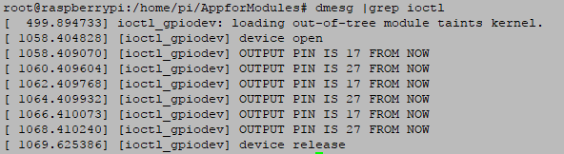
GPIO Simple IOCTL (7)
Result
kernel message

Slide 38
References
[1] 한동훈, 원일용, 하홍준, 리눅스 커널 프로그래밍, 한빛 미디어, 2006.
[2] 백승재, 최종무, 리눅스 커널 내부구조 – Linux Kernel Internals, Art studio, 2015
[3] http://webnautes.tistory.com/554, [Blog]멈춤보단 천천히라도

